Slide 1

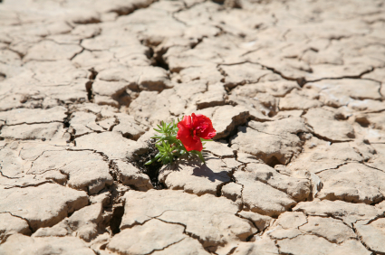
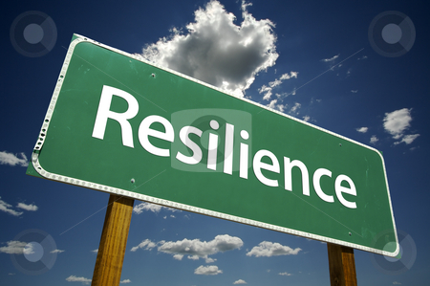
Developing resilience and independence: a Department approach to teaching and learning
Nicola Jones
Daniel Waistell
Comberton Village College
Cambridge

Slide 2
Comberton Village College
11-18 mixed comprehensive
In February 2011 the school became an Academy
The pupil roll is over 1,800
320 in new Sixth Form – opened in September 2011
6 full-time Geography teachers
Department focus for the year…

Slide 3
Resilience: noun
Resilience:
1- the ability of a substance or object to spring back into shape.
2 - the capacity to recover quickly from difficulties; toughness: the often remarkable resilience of so many British institutions.
Independence:
1 - not depending on another for livelihood or subsistence.
2 - capable of thinking or acting for oneself.

Slide 4
C
Confidence
R
Reasoning
E
Empathetic
E
A
T
Active
Tenacious
Everlasting
School Development Plan 2011-14: 2.Teaching and Learning :
To have ensured that the principles embodied in CREATE are successfully embedded within the curriculum
To map and evaluate current opportunities for curricular subject delivery of CREATE principles

Slide 5
Why?
Independent learning
Developing confidence
Managing challenge
Coping with and managing failure – making it okay.
Adapting to change
Preparation for further study
Exams and beyond

Slide 6
OFSTED: Outstanding criteria
2012:
“Teaching promotes pupils’ high levels of resilience, confidence and independence when they tackle challenging activities.”
2013:
“Pupils show exceptional independence; they are able to think for themselves and take the initiative in, for example, asking questions, carrying out their own investigations and working constructively with others. They show significant levels of originality, imagination or creativity in their understanding and skills within the subject”

Slide 7
So what is it to us?
How do we do this as a department?
Can you think independently?
Do you have the tools to take the initiative?
How can you work out the answer yourself?
Can you challenge and overcome failure?
Do you have the confidence to think differently and creatively?
Is there an alternative way you could achieve that? What would help you?
To build confident, independent and resilient learners

Slide 8
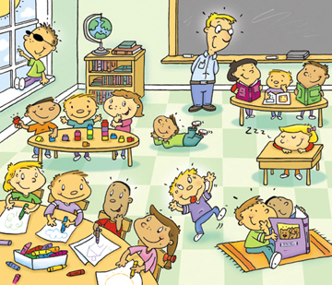


Examples and lessons learnt
Classroom and department perspectives at CVC
Wider applicability

Slide 9
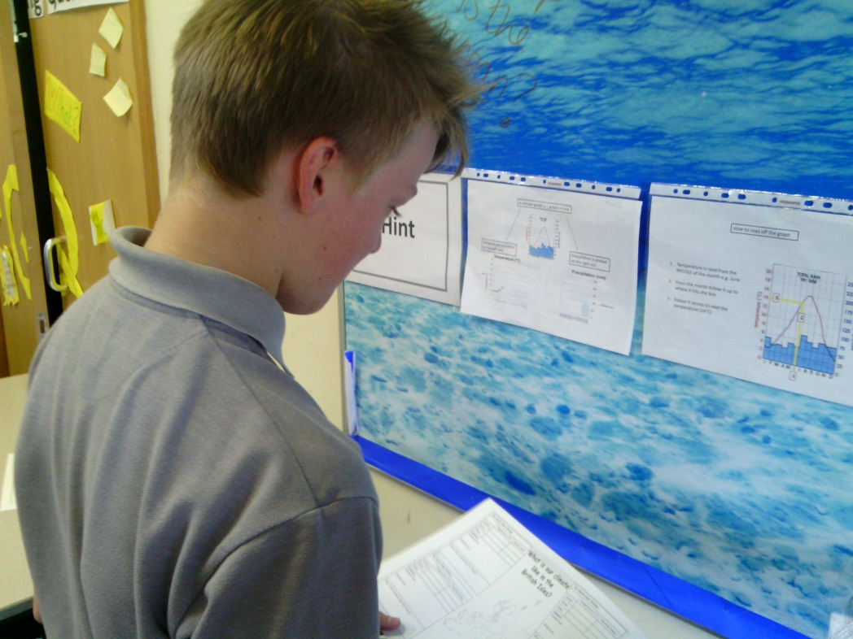
Resilience as…
Differentiation
Struggle, challenge and even failure is not avoided
Self-diagnosed differentiation
Help which demands further thinking
Success at a task that initially seemed beyond their reach
Builds skill levels and confidence

Slide 10

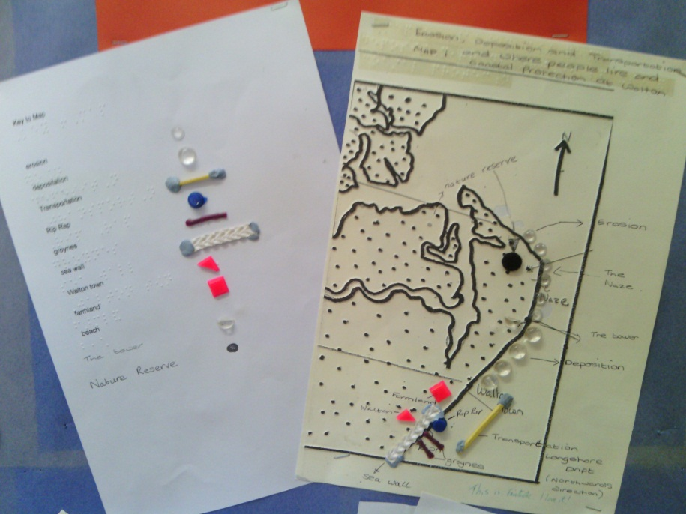
Resilience as…
Inclusion
Sensing Geography differently…
Overcoming weaknesses to achieve potential

Slide 11
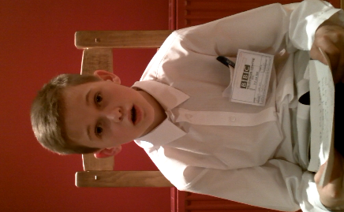
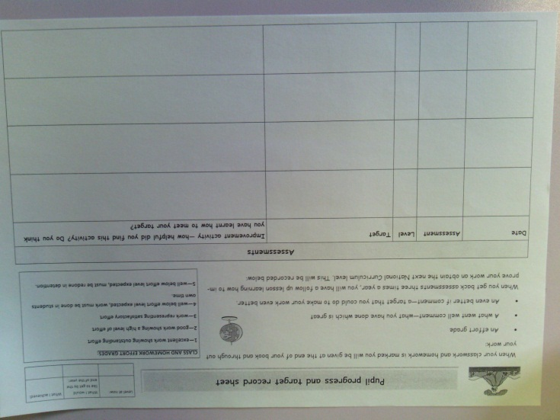
Resilience as…
Assessment
Choice and support but not avoidance at KS3
No
Maybe
Yes
Recognising mistakes and identifying how to improve them
Using targets to build aspiration

Slide 12
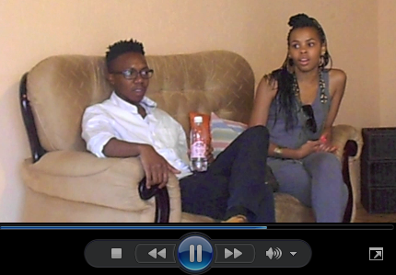
Resilience as…
Independence
Independent projects – building those skills
Exploring questions beyond the scheme of work – confidence to think creatively
Understanding that sometimes the answer isn’t just ‘right or wrong’
Working out your question isn’t going to get the answers you wanted and adapting

Slide 13
What we have learnt?
Choice that builds confidence but doesn’t avoid weaknesses…
Don’t avoid failure. Show that it is an important place to build from…
Build a resilient department…
Resilience is personal…
Of course, these are not the only ways; risk taking, ICT, AfL and more.
How are you building the resilience of your students?

